Slide 1
Design and Implementation of 8-Bit ALU Using VHDL
Course: VLSI
Technology: VHDL
Simulation Tool: ModelSim
Implementation Tool: Xilinx Vivado
Target FPGA: PINE S7 (Spartan-7 XC7S15FTGB196-1)
Presented by: Team VLSI Innovators
Date: 27/02/2026

Slide 2
Introduction to ALU
ALU = Arithmetic Logic Unit
Core component of CPU
Performs arithmetic and logical operations
Operates on binary data
Controlled using selection signals
Produces result output

Slide 3
Project Objective
Aim of the Project
Why 8-bit?
Simple and efficient design
Suitable for learning processor fundamentals
Moderate hardware complexity
Design 8-bit ALU using VHDL
Implement 16 operations using 4-bit select line
Perform multiplication (lower 8 bits only)
Implement division with divide-by-zero protection
Simulate using ModelSim
Implement on PINE S7 FPGA

Slide 4
Functional Operations (16 Operations)
Arithmetic Operations
1.
2.
3.
4.
5.
6
Logical Operations
AND
OR
XOR
XNOR
NAND
NOR
NOT A
NOT B
Shift Operations
Logical Left Shift
Logical Right Shift
(Controlled using 4-bit select input S3 S2 S1 S0)
ADD (A + B)
SUB (A − B)
MUL (Lower 8 bits only)
DIV (With zero check)
INC (A + 1)
DEC (A − 1)

Slide 5
Block Diagram Description
Main Components of the ALU
Two 8-bit Inputs (A and B)
4-bit Selection Input
Arithmetic Unit
Logic Unit
Shifter Unit
16-to-1 Multiplexer
Status Flag Generator
Output
8-bit Result
Flags:
  Carry (C)
  Zero (Z)
  Sign (S)
  Overflow (V)

Slide 6
Design Methodology
VHDL Design Approach
Used IEEE.STD_LOGIC_1164.ALL
Used IEEE.NUMERIC_STD.ALL
Inputs converted to unsigned for arithmetic
Case statement used for operation selection
Combinational process block
Result converted back to STD_LOGIC_VECTOR
Industry-standard coding practice followed.

Slide 7
Simulation and Results
Simulated in ModelSim
All 16 operations tested
Example:
A = 00001111 (15)
B = 00111000 (56)
MUL → 840
Output = 01001000
Division by zero → Output = 00000000
Waveforms confirmed correct functionality

Slide 8
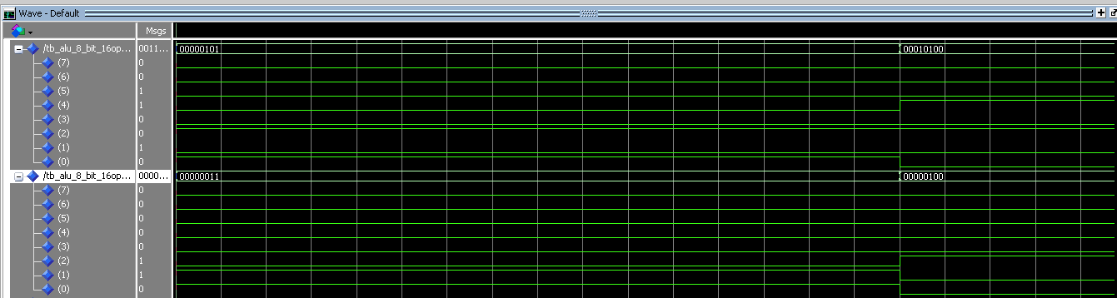
SIMULATION AND RESULT

Slide 9
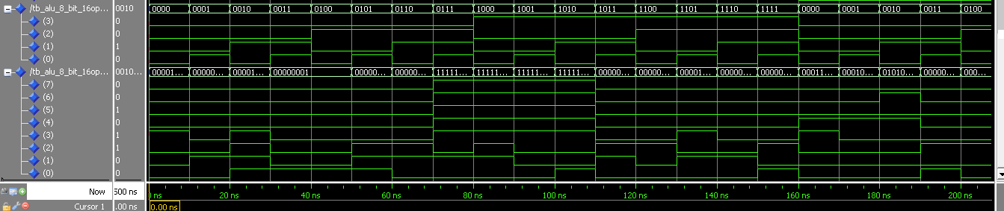
SIMULATION AND RESULT

Slide 10
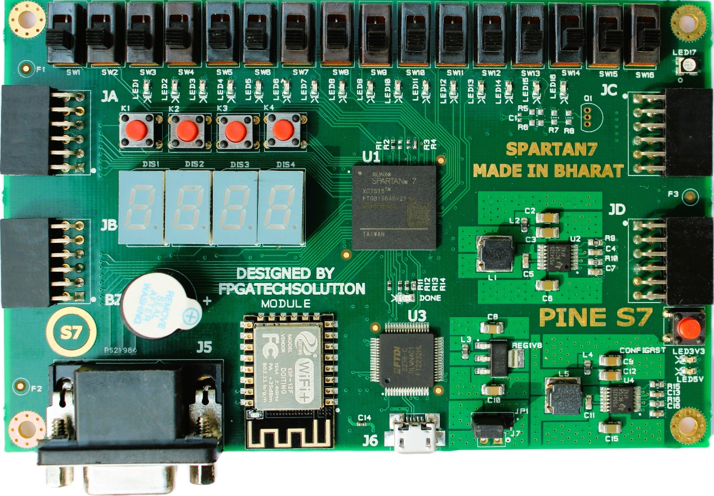
FPGA Hardware Implementation
Target Board: PINE S7 Spartan-7
Input Mapping:
SLIDE_SW[7:0] → Input A
SLIDE_SW[15:8] → Input B
Push Buttons → SEL
Output Mapping:
LED[7:0] → ALU Output
Constraint file (.xdc) used for pin mapping.

Slide 11
Key Features of Our Design
Fully combinational ALU
16 functional operations
Multiplication truncation handled correctly
Divide-by-zero protection implemented
Synthesizable design
Scalable to 16-bit and 32-bit systems

Slide 12
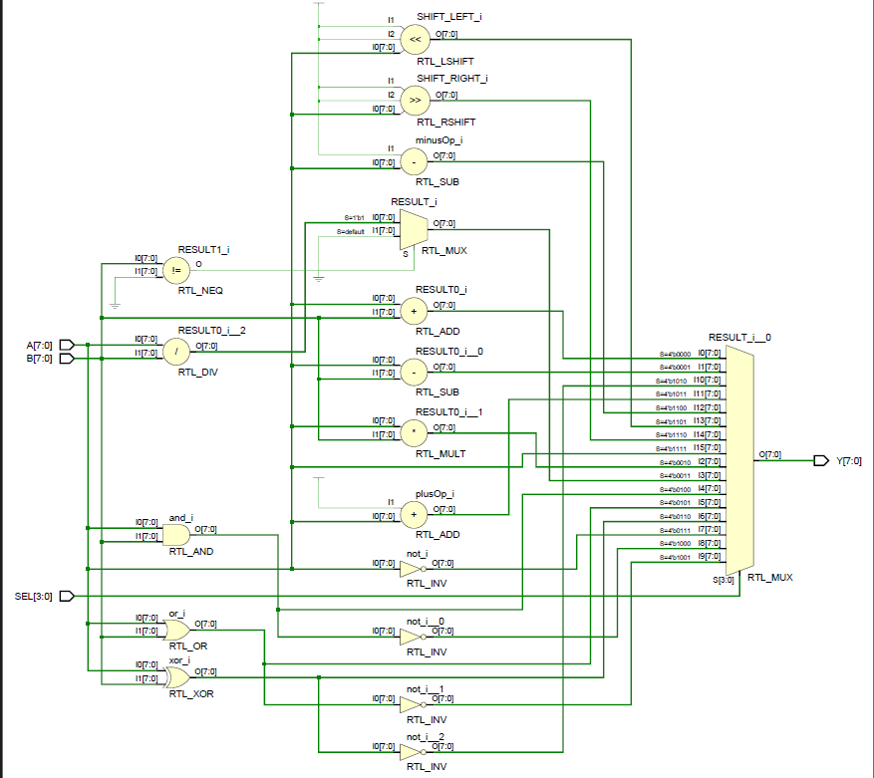
Synthesized design

Slide 13
Conclusion and Future Scope
Conclusion
Successfully designed 8-bit ALU
Implemented 16 operations
Verified using simulation
Implemented on FPGA hardware
Future Improvements
Add carry, zero and overflow flags
Extend to 32 bit ALU
Integrate in simple processor

Slide 14
THANK YOU

Slide 15

ANY QUESTIONS ???

